Slide 1


A case study of the use of one module in a peer review
(Viggiano, Italy)
Giuseppe Guarino (Gruppo Lucano)
Giuseppe Priore (Viggiano City Council Member)
Luciano Garramone (Italian Space Agency, Matera)
Antonio Priore (Consultant, Editor of Viggiano PEC)
Uscore2 Masterclass
EFDRR, Rome, November 21-23, 2018

Slide 2
Summary of Viggiano peer review
Five Modules reviewed:
Module 2: Identify, Understand and Use Current and Future Risk Scenarios
Module 4: Pursue Resilient Urban Development and Design
Module 5: Safeguard Natural Buffers to Enhance Ecosystems’ Protective Functions (Climate Change Adaptation)
Module 7: Understand and Strengthen Societal Capacity for Resilience
Module 9: Ensure Effective Disaster Response
Review Duration: three days (October 25-27, 2017)
Review Team : 13 reviewers

Slide 3
How we chose the modules
Viggiano is a small community of 3.300 people in South Italy
Most severe risk:
earthquake with history of magnitude 7 events and classified as Zone 1 (that of highest danger) in the national seismic chart
Level of Exposure strongly increased in the last 20 years:
national strategic value in the energy sector (largest oil field on continental Europe)
interregional strategic value in the water supply (large water dam)
national strategic value in the environment (Appennino National Park, part of the largest ecological corridor in Europe)
New risk scenario:
Natech with complex cascading effects on technological and civil infrastructures
(case study scenario valuable at the international level)

Slide 4
Objectives and Methodology
Viggiano peer review objectives
Improve the level of understanding, participation and coordination on DRR among the different stakeholders.
Spread the results among the population to improve not only understanding on DRR but also the level of trust towards the institutions.
Viggiano peer review methodology
Mainly based on presentations, interviews and site visits.
Each module had some variations on the methodology.
47 stakeholders participated to the peer review

Slide 5
Module 9: capacity response
Step 7 (in the Guide): prepare and supply pre-visit information for the peer review
we could rely on a good City Emergency Plan as a starting point
in consideration of the level of most severe risk and local limited resources was important to highlight the interaction with the regional and national level
guarantee a good summary and quality translation
Step 8 (in the Guide): prepare and agree the agenda for the peer review
feedback process between host and review team
    we had the advantage that we had been working with the review team through the initial phase of Uscore 2
    we had the disadvantage that the process was still at experimental stage
identify the relevant stakeholders
    for a small community many relevant stakeholders are non-municipality entities
    completing the DRS was an important step

Slide 6
Step 9 (in the Guide): undertake the peer review
general presentation on governance of disaster response
  we did not need to include risk analysis because module 2 was part of the review
  make sure that the complex process of the response mechanism (different roles of the local, regional and national stakeholders) is well presented
interviews and presentations from 8 stakeholders (provincial and local Civil Protection, firefighters, local and state police, ENI, civil protection volunteers, health structures)
  have the stakeholders prepared and, if opting for a presentation+interview, make sure of the time allocation (because we had to manage 47 stakeholders for the all peer review we were not able to go through a satisfactory preparation process)
language translation (this may add considerable cost to the review)
  we had translators, but not in real time, this slowed down the process considerably

Slide 7
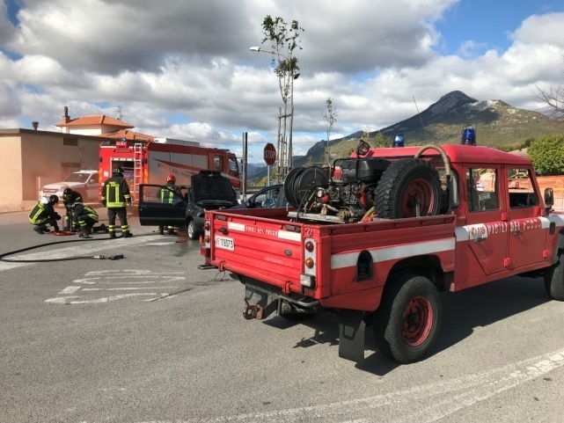
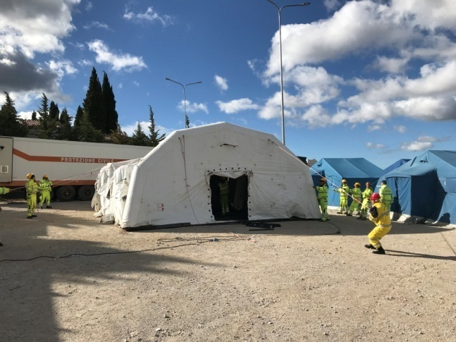
a full scale 24 hours emergency drill simulating the response to an earthquake disaster to test the City Emergency Plan.
  participants: the mayor, 35% of the population, 286 civil protection volunteers, 10 members of the Viggiano administration, 18 firefighters, 10 state police, 3 local police, 4 members of the 118 (emergency medical aid), 28 representatives of other cities administrations
  full scale drill for the Viggiano urban area
  all the emergency procedures and structures as stated in the City Emergency Plan were tested and gaps identified
  a sample (3%) of the population that did not participated was subsequently interviewed to identify causes

Slide 8
Lesson learned on Viggiano Capacity Response
Being peer reviewed:
forced us to look at the local response capacity in all the details, in particular the interaction among the different stakeholders and their role (ie. the provision of a radio system that could be accessed and utilised by all emergency responders)
allowed us to identify most of the gaps in our City Emergency Plan
evidenced the need to improve the communication between local, regional and national level (ie. extend the drills also to the industrial areas and to different risks)
showed us the importance to develop a process to record and implement the lessons identified in disaster exercises that could ensure these lessons are embedded in future plans.

Slide 9
Lesson learned on hosting the peer review
Select only 1 or 2 modules for the first peer review
Choose the methodology very carefully
  one general presentation for each module that summarize the pre-visit info
  single stakeholder interviews (unless one wants to allocate more time to the review process and to use presentation and/or a focus group approach)
Good preparation of the stakeholders
providing them with the proper documentation on the peer review
meetings to explain the process and the objectives
Organize a site visit for each module before stakeholder’s interviews
Make available a professional real time translation

Slide 10
Benefits from the Viggiano Peer Review
Improved community resilience and response providing important indication about gaps and strengths in term of governance of prevention, response and recovery (first full scale drill on disaster response and increased awareness among the population)
Stakeholders participation to city resilience (first time participation of many stakeholders and relevant public and private stakeholders are becoming proactive in building city resilience and DRR)
Increase in economy of knowledge and in human capital available for resilience (team of experts on resilience and master for young university graduates to acquire skills on definition of new resilience projects)
Increased recognition at the national level of the bottom up approach to resilience that gained to Viggiano the recognition of Role Model City in the MCR campaign
Starting to develop disaster risk reduction and city resilience strategies

Slide 11
Conclusions
Did we reached our two objectives?
YES
Did we start to see positive impacts?
YES
What next?
Build with the participation of all relevant stakeholders
a city resilient strategy
Thank You

